Slide 1
NAME :
RAJA.R
DOMAIN:BIOTECHNOLOGY
TASK: 2
CASE STUDY ANALYSIS ON BIOCON COMPANY

Slide 2
INNOVATION:
Biosimilars: Biocon boasts a robust pipeline and is a pioneer in bringing affordable alternatives to expensive biologics in advanced markets across the globe. [1, 2, 3]
Novel Biologics: The company develops in-house cutting-edge therapies, including the first indigenously developed novel monoclonal antibody in India, Nimotuzumab, for head and neck cancer. [1]
Immuno-oncology: Through clinical-stage biotechnology entities like
Therapeutics, Biocon anchors the development of bifunctional antibodies. [1]
Global Collaborations: With headquarters in Bengaluru, Biocon continues to push the envelope in global healthcare through strategic R&D and international partnerships. [1, 2, 3, 4, 5]

Slide 3
BIOCON is a leading Indian biopharmaceutical company dedicated to making therapies accessible and affordable globally. Through its subsidiary, it delivers an extensive portfolio of biosimilars for oncology and autoimmune diseases, as well as affordable insulin analogs for diabetes care.
Pioneering Insulin:
Biocon was the first company in the world to develop and
commercialize recombinant human insulin (rh-insulin) using a
proprietary yeast expression platform.
Immuno-Oncology:
Through its U.S.-based clinical-stage affiliate, Bicara Therapeutics, Biocon is accelerating the development of bifunctional antibodies aimed at malignant tumors. [1]
GLP-1 Weight Management:
Biocon has expanded its footprint into chronic weight management
and diabetes by developing FDA-approved Liraglutide injections
and GLP-1 peptides.

Slide 4
Products :
tAt Biocon, we focus on three core therapeutic areas—Diabetes, Oncology and Immunology—and address some of the world’s mos urgent healthcare needs. Through deep scientific expertise, world-class R&D, and a robust global infrastructure, we advance high-quality biosimilars that make essential treatments more affordable and accessible.
Our therapies help manage chronic and complex diseases for millions of patients. Building on this foundation, we are expanding our pipeline into Ophthalmology and Bone Health to further address unmet medical needs and improve health outcomes.
Branded Formulations
A segment composed of a portfolio containing more than 70 distinct brands targeted primarily at domestic market leadership across multi-specialty healthcare verticals in India. [1]
Would you like to drill down into the clinical trial pipeline for their GLP-1 generics, or see the regulatory approval status of their biosimilars in US

Slide 5
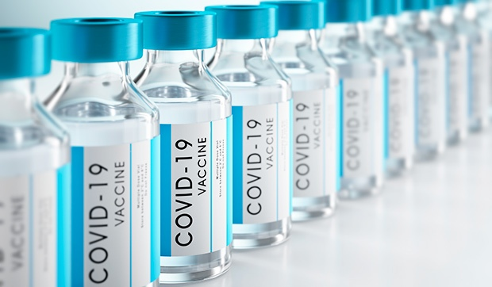
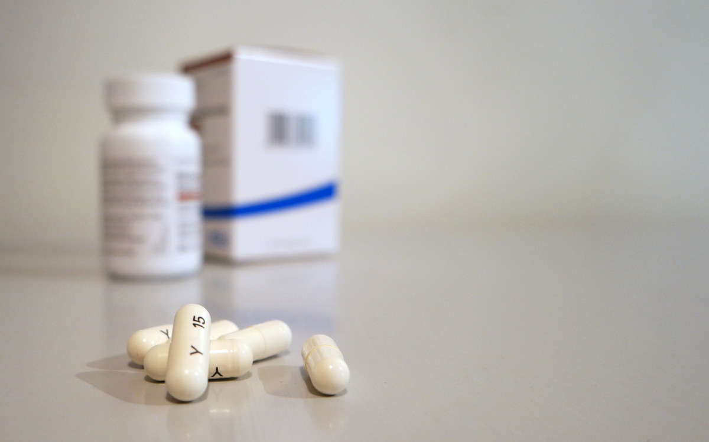
Generic Formulations & APIs
Biocon manufactures and supplies Active Pharmaceutical Ingredients (APIs) and finished oral solid/parenteral formulations globally. The portfolio includes immunosuppressants (e.g., Tacrolimus, Everolimus), anti-diabetics (e.g., Semaglutide, Liraglutide), and oncology medications (e.g., Lenalidomide, Olaparib). [1, 2, 3, 4]
For a full directory of available Biocon therapeutics, APIs, and commercialized biosimilar products, you can explore their official Biocon Products portal. For patient and regional availability information, consult the Biocon Biologics Products directory

Slide 6
Challenges :
DIABETES
Helping 1 in 5 insulin-dependent people around the world with simple solutions
ONCOLOGY
Our scientists are working relentlessly to provide transformative therapies to cancer patients
IMMUNOLOGY
Pioneers in targeted therapies and exploring potential treatments for patients with immune dysfunctions.
Ophthalmology
Bringing advanced biologics that protect and preserve vision for patients worldwide
Bone Health
Committed to improving bone strength and quality of life through innovative, affordable biologics

Slide 7
Market impact :
Biosimilar Dominance: Biocon Biologics commands a massive commercial footprint across over 100 countries, serving over 6 million patients annually. By securing approvals for interchangeable biosimilars (like Kirsty and Yesafili), the company undercuts expensive originator biologics, reducing public healthcare expenditures. [1, 2, 3, 4]Market Reaction to Approvals: The company's stock consistently reacts to product pipeline milestones. For instance, after securing U.S. FDA approvals for crucial drugs targeting billion-dollar markets, shares typically experience noticeable upward trading pressure. [1]Financial Performance: Recent performance shows robust double-digit operational revenue growth—nearly 13% YoY in core segments—while strategically expanding its EBITDA margins through disciplined cost-cutting and focused debt reduction. [1, 2, 3]Global Weight Management: Biocon’s recent FDA and European approvals for generic Liraglutide for diabetes and weight management position it to capture high-value market share in the rapidly expanding anti-obesity and metabolic drug sectors. [1]

Slide 8
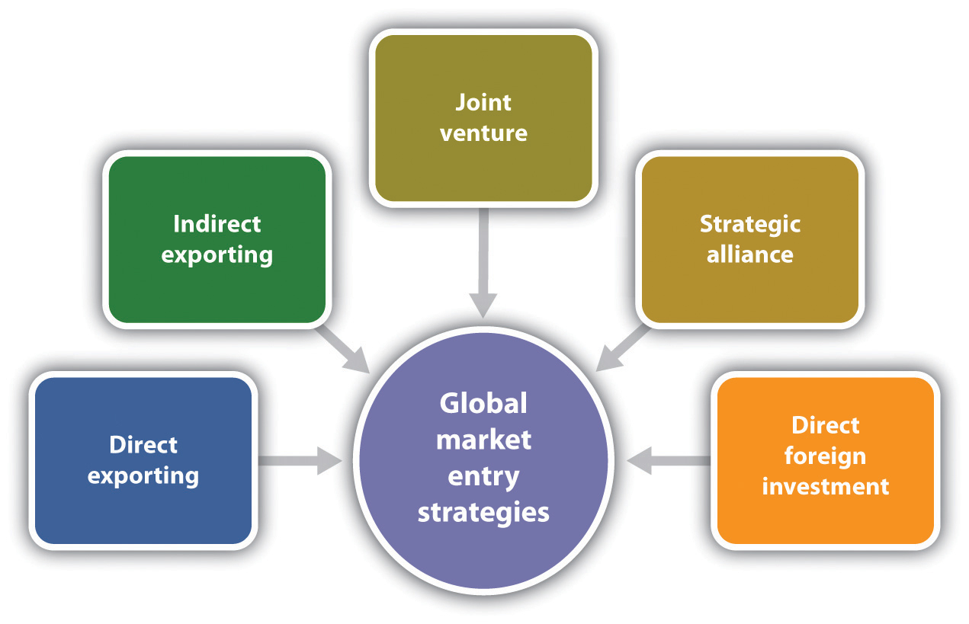
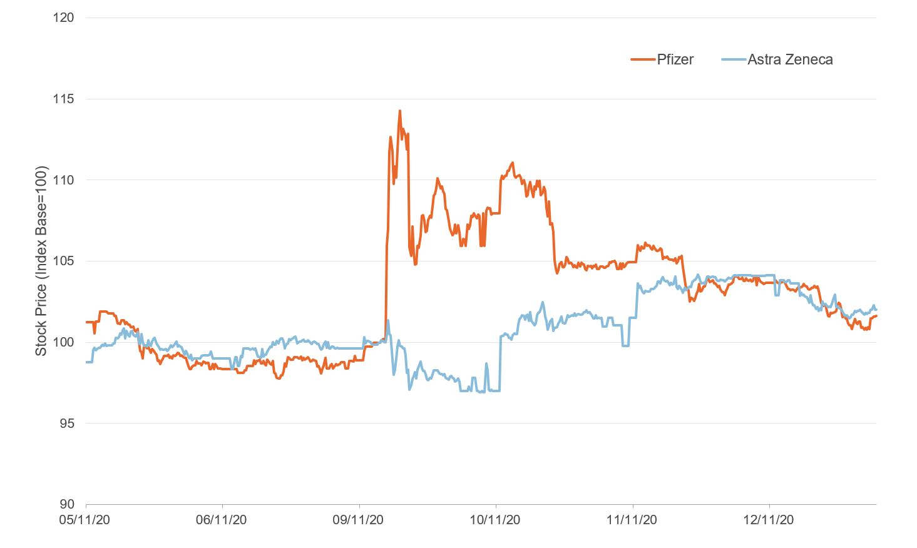

Slide 9
Application :
Major Medical Applications
Diabetes Management: Biocon is a top global producer of affordable insulins, including rh-Insulin, Insulin Glargine, and Insulin Aspart [1]. [1, 2, 3, 4]
Cancer Therapy (Oncology): The company manufactures vital biosimilars like Trastuzumab (for breast cancer) and Bevacizumab (for colorectal and lung cancers). [1, 2, 3, 4]
Autoimmune Diseases (Immunology): Biocon develops novel biologics like Itolizumab to treat severe plaque psoriasis and inflammatory conditions. [1, 2, 3, 4, 5]
Organ Transplants: It produces high-quality immunosuppressants (like Tacrolimus and Cyclosporine) to prevent organ rejection in transplant patients. [1, 2]
Cardiovascular Health: The company manufactures generic statins (such as Atorvastatin and Simvastatin) to help manage cholesterol levels. [1, 2]

Slide 10
Methods to manufacturing :
[Upstream Expression] ➔ [Fermentation & Synthesis] ➔ [Downstream Purification] ➔ [Aseptic Fill-Finish]
Upstream Expression: Genetically engineers yeast (Pichia pastoris) or mammalian cells (CHO) to serve as target molecule factories.
Fermentation & Synthesis: Cultivates cells in massive automated bioreactors (or hybrid chemical rigs) to grow the raw therapeutic substance.
Downstream Purification: Isolates and strips out impurities using precision target-specific chromatography and multi-stage fine filtration. [1]
Aseptic Fill-Finish: Formulates the pure medicine inside sterile Grade A cleanrooms directly into final pens, syringes, or vials.m

Slide 11


